Slide 1
A
Acute treatment of HUVEC for glucose and deoxy-D-glucose uptake assay
Ctrl, Q, Q3’S, Q3G
5.5 mM deoxy-D-glc/¹⁴C-deoxy-D-glc
or 5.5 mM glc/¹⁴C-glc
RPMI
5.5 mM glc
2% FCS
Ctrl, Q, Q3’S,Q3G
No glc, RPMI
Radioactivity quantification
10 min
5-20 min
B
C
D
18-h treatment of HUVEC for glucose and deoxy-D-glucose uptake assay
Ctrl, Q, Q3’S, Q3G
5.5 mM glc
0.2% FCS
5.5 mM deoxy-D-glc/¹⁴C-deoxy-D-glc
or 5.5 mM glc/¹⁴C-glc
RPMI
5.5 mM glc
2% FCS
5.5 mM glc
0.2% FCS
No glc
RPMI
Radioactivity quantification
1 h
18 h
10 min
20 min
E
F
Figure 1
Notes:
B: n=21-33
C: n=6
E: n=12-36
F: n=14

Slide 2
A
B
Basal PDK4/TBP=0.12±0.02
C
D
Basal ACAA1/TBP=1.44±0.04
E
F
Basal PFKFB3/TBP=1.53±0.42
G
H
Basal MDR1/TBP= 0.34±0.01
I
J
Basal OATP4C1= 0.27±0.06 copies/ng
Figure 2
Notes:
PDK4=3-6
ACAA1 =3
MDR1=3
PFKFB3 = 3-5
OATP4C1=3

Slide 3
A
B
HO-1
kDa
C
D
E
F
Figure 3
Notes:
A: n=3
B n=2
D n=5 (n=7 for Q)
E n=2-3
F: n=13

Slide 4
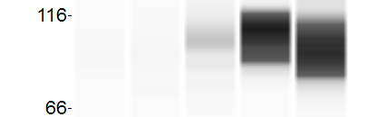
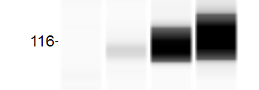
A
HIF1α
B
HIF1α
C
D
E
F
Figure 4
Notes:
A
B
D: n=18-24
E: n=24
F: n=12-18

Slide 5
A
B
C
Basal GYS1/TBP=2.20±0.76
Basal PDK1/TBP=0.482±0.036
Basal PDK2/TBP=2.22±0.51
Basal GYS1/TBP=2.40±0.57
Basal PDK1/TBP= 0.507±0.022
Basal PDK2/TBP=1.31±0.56
D
E
F
Basal PDK3/TBP=0.60±0.05
Basal PDK4/TBP=0.20±0.02
Basal HO-1/TBP=1.81±0.99
Basal PDK3/TBP=0.52±0.06
Basal PDK4/TBP=0.12±0.02
Basal HO-1/TBP=2.83±0.38
G
I
J
Basal G6PD/TBP=6.10±1.99
Basal PFKFB4/TBP=0.11±0.04
Basal PFKFB3/TBP=1.05±0.12
Basal G6PD/TBP=8.51±1.24
Basal PFKFB4/TBP=0.14±0.01
Basal PFKFB3/TBP=1.53±0.42
Figure 5

Slide 6
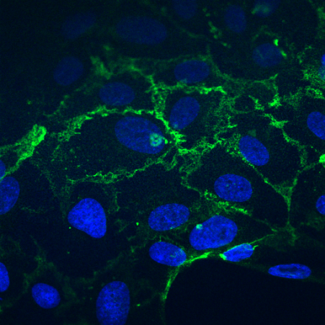
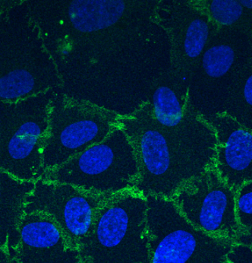
A
B
C
D
CD31/DAPI
DMSO
Quercetin
20 μm
E
F
G
Figure 6
Notes:
A-B n=6-9
C n=9
E-G n=3

Slide 7
A
B
4h
18h
Figure 7

Slide 8
GLUCOSE
Quercetin
GLUT
Nrf2
G6PD
HO-1
GLUCOSE-6-P
PPP
HIF1α
PFKFB3
GLYCOLYSIS
PDK4
PDH
PYRUVATE
ACETYL-CoA
LIPID SYNTHESIS
LACTATE
Figure 8

Slide 9
A
B
Supplementary Figure 1

Slide 10
Supplementary Figure 2

